Slide 1
Web Performance APIs Deep Dive Workshop
Dan Shappir, Performance Tech Lead at Wix.com
dansh@wix.com twitter@DanShappir www.wix.engineering

Slide 2
Hi.
I’m Dan
Performance Tech Lead at Wix R&D
Making over 100 Million sites load and execute faster
dansh@wix.com twitter@DanShappir www.wix.engineering

Slide 3
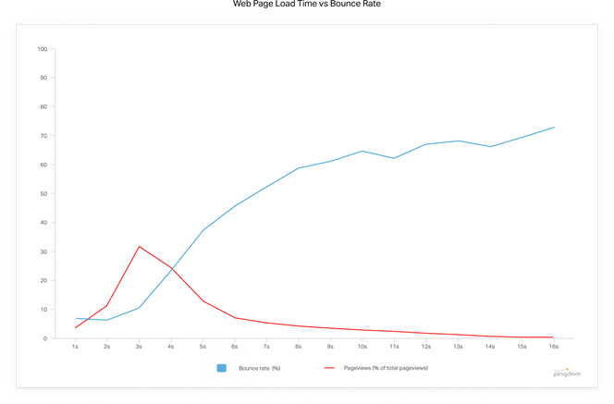
A website’s performance is critical to its success.
Bounce Rate (%)
Pageviews (%)
Source: Pingdom, 2018
Notes:
Almost half of pageviews have a load time of over 4 seconds, which results in Bounce Rate of over 25%
And 25% of pageviews have a Bounce Rate of over 45% due to slow load!
Do they even know?!?

Slide 4
Web performance APIs are a Web Standard.
APIs
Expose information about the performance of network & internal browser operations.
supported by all modern browsers

Slide 5
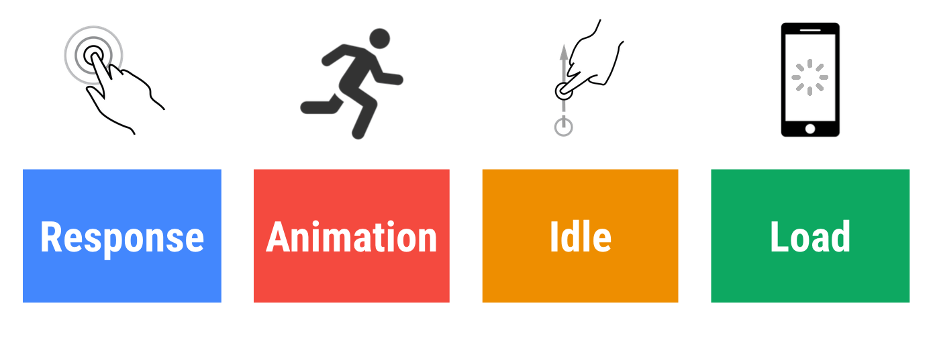
What to Measure
The RAIL model breaks down the user's experience into key actions:

Slide 6
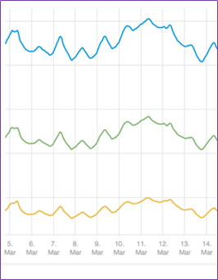
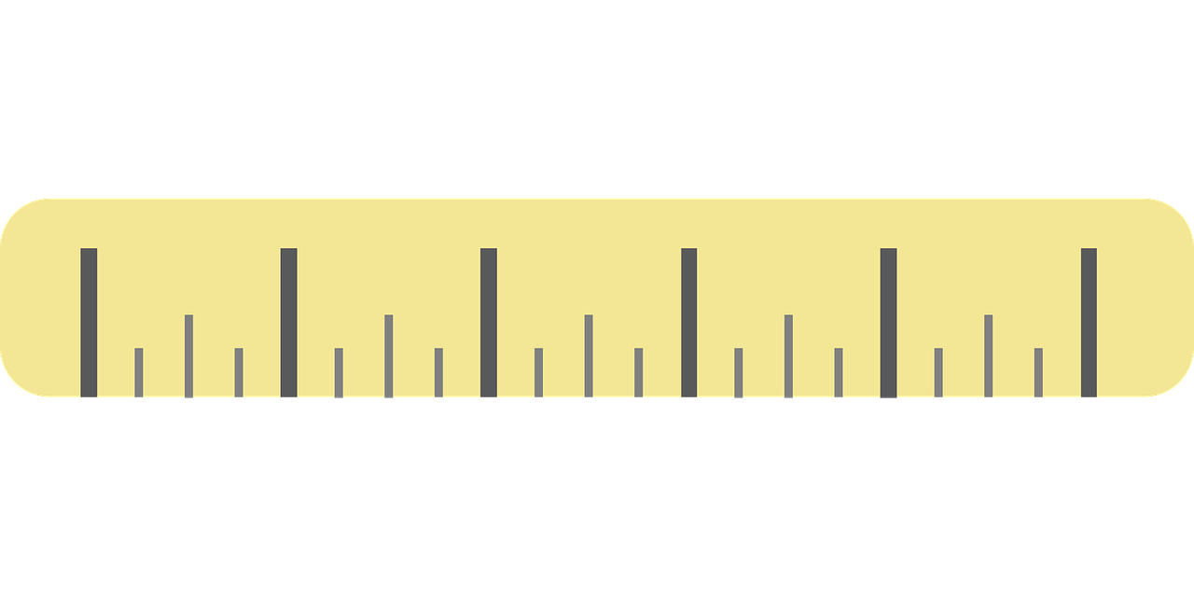
When to Measure
Locally (your session)
Synthetic sessions
Real (User sessions)
Dev-time
Pre-release
Production
Notes:
If you don’t measure, you won’t really know where your problems are and what works well or not.
You can use the APIs to take measurements in 3 different stages

Slide 7
Example of Wix Measurements in Production (RUM)
DNS Time
Response Time
Notes:
Performance graphs used at Wix

Slide 8
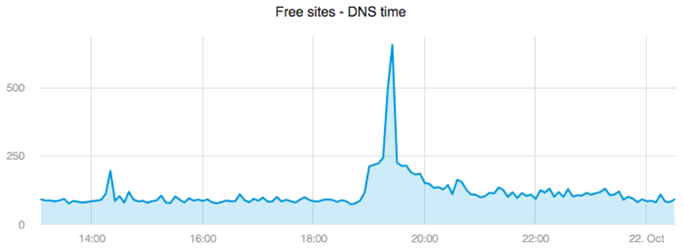
When you’re measuring with performance APIs, you can quickly react to unexpected events.
What DDoS On DNS Looks Like
DNS Time
Notes:
Dyn cyberattack took place on October 21, 2016: https://en.wikipedia.org/wiki/2016_Dyn_cyberattack

Slide 9
Let the deep dive begin!

Slide 10
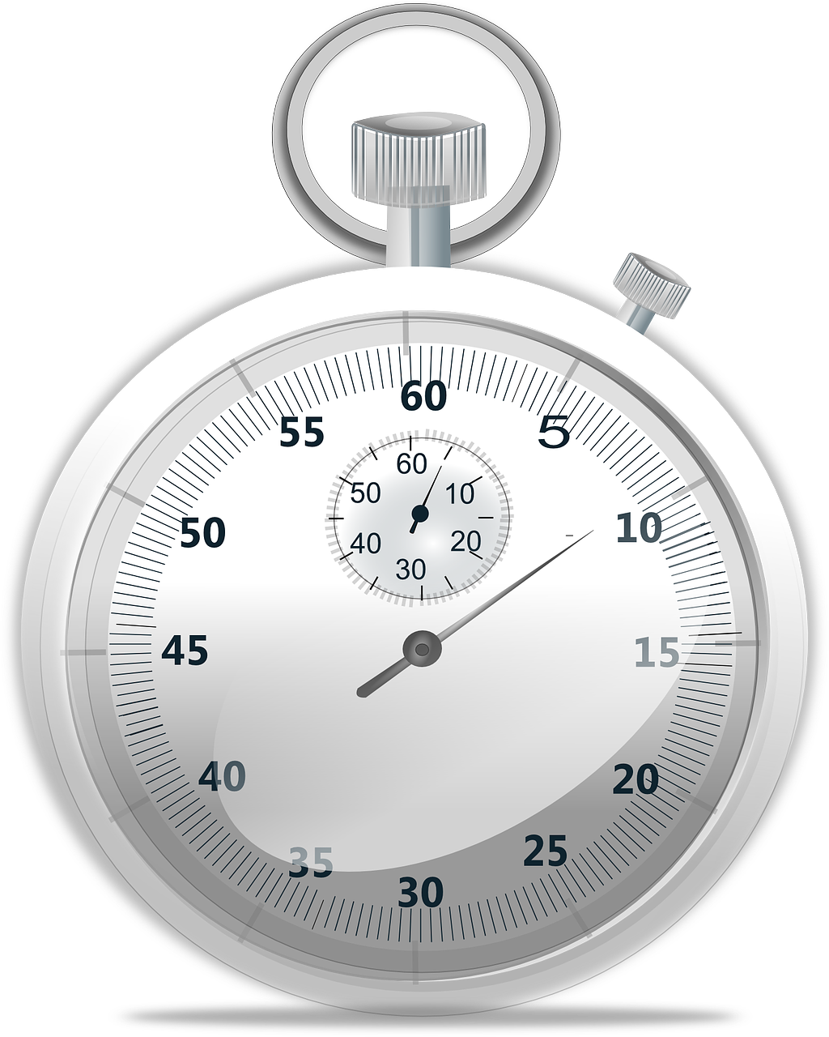
B
A
Date.now() or new Date() are not appropriate.
timeOrigin
now()
window: navigation start
worker: execution start
Time since origin
Notes:
The difference between any two chronologically recorded time values, with the same origin, must never be negative

Slide 11
B
A
Instead, we use high resolution timestamps.
timeOrigin
now()
DOMHighResTimeStamp
Monotonic, uniformly increasing timestamp, unaffected by system clock changes

Slide 12
Useful for: RAIL
API #1 High Resolution Time
interface Performance {
DOMHighResTimeStamp now();
readonly attribute DOMHighResTimeStamp timeOrigin;
object toJSON();
};
window.performance.now();
window.performance.timeorigin;
Notes:
DOMHighResTimeStamp should represent a time in milliseconds accurate to 5 microseconds, but may be just milliseconds on old browsers. DOMHighResTimeStamp resolution may be decreased in the future to prevent fingerprinting

Slide 13
toJSON method (In most performance interfaces)
interface Performance {
DOMHighResTimeStamp now();
readonly attribute DOMHighResTimeStamp timeOrigin;
object toJSON();
};
window.performance.now();
window.performance.timeorigin;
Notes:
Exists in most performance interfaces (excluded for brevity)
Standard serializer: returns a representation of a performance object, as a simple object, with literal key/value pairs
Used automatically by JSON.stringify()
Also useful for filtering, itreations, etc.

Slide 14
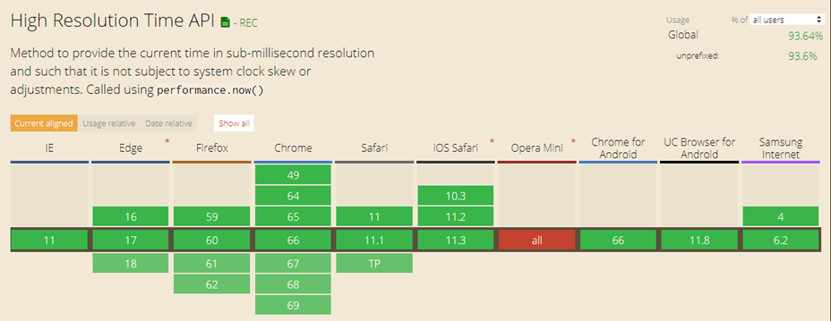
Can I use High Resolution Time API?

Slide 15
Exercise #1 High Resolution Time API
1. Open the Dev Tools Console 2. Measure the time of an empty loop with 1,000,000 iterations 3. Measure the time of an empty loop with 1,000,000,000 iterations

Slide 16
Page Load
From the users’ perspective, they wait from clicking the link until the content is displayed.
Link is clicked before your code is even loaded. Difficult to determine when content is initially displayed.

Slide 17
PerformanceEntry
a collection of related metrics
Browsers store info for performance related events in an internal buffer.
Stored info is exposed via API as a sequence of PerformanceEntry items, sorted by event start time.
Notes:
▪A unified interface to obtain various performance metrics
▪Organized as a sequence of performance entries
▪Each entry is a collection of related metrics, e.g. all metrics for a specific resource
▪Timeline ordered by start time

Slide 18
PerformanceEntry
a collection of related metrics
Entries have a specific derived type (based on event).
PerformanceNavigationTiming
PerformanceResourceTiming
PerformancePaintTiming
PerformanceMark
PerformanceMeasure
PerformanceLongTaskTiming
PerformanceFrameTiming

Slide 19
Useful for: RAIL
API #2 Performance Timeline
partial interface Performance {
PerformanceEntryList getEntries();
PerformanceEntryList getEntriesByType(DOMString type);
PerformanceEntryList getEntriesByName(DOMString name,
optional DOMString type);
};
typedef sequence<PerformanceEntry> PerformanceEntryList;

Slide 20
Useful for: RAIL
API #2 Performance Timeline (cont)
interface PerformanceEntry {
readonly attribute DOMString name;
readonly attribute DOMString entryType;
readonly attribute DOMHighResTimeStamp startTime;
readonly attribute DOMHighResTimeStamp duration;
};

Slide 21
How quickly does the page’s HTML load?
First entry in the buffer contains HTML load info.
Navigation Timing

Slide 22
Breaking Down the Navigation Timing
startTime
redirectStart
redirectEnd
fetchStart
requestStart
responseStart
responseEnd
loadEventStart
loadEventEnd
Prompt for unload
redirect
App cache
DNS
TCP
Request
Response
Processing
Load
unload
DomContentLoaded
unloadEventStart
unloadEventEnd
domainLookupStart
domainLookupEnd
connectStart
secureConnectionStart
connectEnd
domInteractive
domContentLoadedEventStart
domContentLoadedEventEnd
domComplete

Slide 23
Useful for: L
PerformanceNavigationTiming obtained by Performance Timeline API
performance.getEntriesByType("navigation")
entryType: "navigation"
name: URL
startTime: 0
duration: total time until after onload
type: "navigate", "reload", "back_forward", ...
transferSize, encodedBodySize, decodedBodySize
nextHopProtocol: "http/1.1", "h2", ...

Slide 24
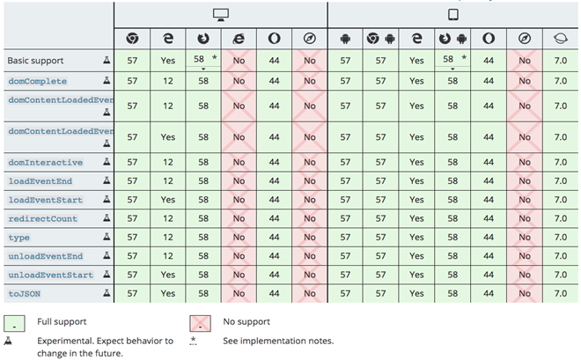
Can I use PerformanceNavigationTiming

Slide 25
Exercise #2 Performance Timeline API
1. Use O’Reilly Fluent Conference
2. Measure DNS lookup time
3. Measure TTFB
4. Compare for cached vs uncached pages

Slide 26
Useful for: L
API #3 Navigation Timing
window.performance.timing - access navigation timings
window.performance.navigation - access navigation type and redirect count
Time values are Unix Epoch, like Date.now()
For older browsers

Slide 27
What have we learned
High Resolution Time
Performance Timeline
use high resolution timestamps
access a sequence of performance entries
Get “navigation” entry
Navigation Timing
for older browsers

Slide 28
Resource Timing all downloads except HTML
Only successful downloads are included
No indication for caching (privacy)
<iframe> has its own resource timings, but extensions may be included
For cross-domain resources, add to response header: timing-allow-origin: * (otherwise, most properties will be set to zero)
Notes:
Timing-Allow-Origin works like Access-Control-Allow-Origin:

Slide 29
Breaking Down the Resource Timing
startTime
redirectStart
redirectEnd
fetchStart
requestStart
responseStart
responseEnd
redirect
AppCache
DNS
TCP
Request
Response
domainLookupStart
domainLookupEnd
connectStart
secureConnectionStart
connectEnd

Slide 30
Useful for: L
API #4 Resource Timing
performance.getEntriesByType("resource")
PerformanceResourceTiming.startTime...
PerformanceResourceTiming.initiatorType:
"script", "link", or "img" for HTML
"css" for fonts, background images etc.
"xmlhttprequest" for XMLHttpRequest
"beacon" for sendBeacon
"" for fetch(), new Worker() etc.

Slide 31
2 GOTCHAs when looking at entry data
The browser performs certain actions at most once per Session others per Connection and others per Resource.
DNS lookup
TCP connect
SSL Handshake
HTTP request
HTTP response

Slide 32
Resource Timing
GOTCHA #1
For resources from the same domain,
DNS will only be included for the 1st entry.
“24”
“0”
“0”
The browser performs certain actions at most once per Session others per Connection and others per Resource.
DNS lookup
TCP connect
SSL Handshake
HTTP request
HTTP response

Slide 33
Resource Timing
GOTCHA #2
Resources that wait for DNS or SSL handshake are blocked - the user experiences a delay you don’t see.
“24”
“0”
“0”
PerformanceResourceTiming duration includes blocked time.
Without timing-allow-origin all you have is duration.
Limit on number of parallel downloads (HTTP/1.1)
Processing previous requests (HTTP/2)
DNS or SSL handshake instigated by previous request

Slide 34
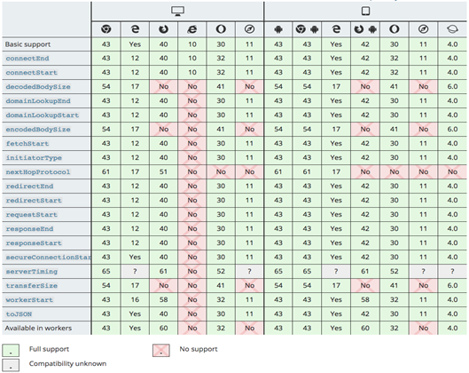
Can I use Resource Timing API

Slide 35
Exercise #3 Resource Timing API
1. Use Rich image site with timing-allow-origin
2. Compare image sizes with / without caching
3. Calculate longest and average image download duration
4. Special challenge: calculate SSL handshake time for image download

Slide 36
Browsers generally limit entry buffer size (recommended minimum is 150 entries).
When full, additional entries are not recorded.
performance.getEntries

Slide 37
Useful for: RAIL
How to overcome buffer size limitations
partial interface Performance {
void clearResourceTimings();
void setResourceTimingBufferSize(unsigned long maxSize);
attribute EventHandler onresourcetimingbufferfull;
};
Beware of unlimited buffer size growth!

Slide 38
Demo DevTools Overrides

Slide 39
Exercise #4 Performance Entry Buffer
1. Use O'Reilly Fluent speakers page
2. Use overrides to resize entries buffer so that all speaker images fit
3. Use an event handler to resize only when space runs out. Increase by 10% each time. Assume initial size is 150
Notes:
performance.getEntriesByType('resource').filter(({initiatorType,name}) => initiatorType === 'img' && name.includes('user_'))
var resourceTimingBufferSize = 150;
performance.addEventListener("resourcetimingbufferfull", function () {
resourceTimingBufferSize *= 1.1;
this.setResourceTimingBufferSize(resourceTimingBufferSize);
});

Slide 40
request
response
We’ve seen request duration, the next API is about time spent on the server, e.g.
Computations
DB queries
Microservices
Notes:
▪Integrating and synchronizing server-side measurements can be difficult
▪Or you may want to check impact of different client-side queries on server timings during dev

Slide 41
Example HTTP response with Server Timing information
> GET /resource HTTP/1.1
> Host: example.com
< HTTP/1.1 200 OK
< Server-Timing: miss, db;dur=53, app;dur=47.2
< Server-Timing: customView, dc;desc=atl
< ... response body ...

Slide 42
Useful for: L
API #5 Server Timing
partial interface PerformanceResourceTiming {
readonly attribute FrozenArray<PerformanceServerTiming> serverTiming;
};
interface PerformanceServerTiming {
readonly attribute DOMString name;
readonly attribute DOMHighResTimeStamp duration;
readonly attribute DOMString description;
};

Slide 43
Observers notify you when certain browser events happen.
MutationObserver
IntersectionObserver
ResizeObserver
PerformanceObserver
notifies when new performance entries are created.

Slide 44
Useful for: RAIL
How to use PerformanceObservers
const observer = new PerformanceObserver((list, src) => {
// src === observer
const entries = list.getEntries();
...
});
observer.observe({entryTypes: ["resource"]});
...
observer.disconnect();

Slide 45
Exercise #5 Performance Observer
1. Use O'Reilly Fluent speakers page
2. Use PerformanceObserver to retain all speaker images entries, without increasing the buffer size (by copying into an array)
Notes:
const images = [];
const observer = new PerformanceObserver((list) => {
const entries = list.getEntries().filter(({initiatorType,name}) => initiatorType === 'img' && name.includes('user_'));
images.push(...entries);
});
observer.observe({entryTypes: ["resource"]});

Slide 46
Useful for: L
API #6 Paint Timing
performance.getEntriesByType("paint") OR using PerformanceObserver
"first-paint" - when the browser first rendered after navigation
"first-contentful-paint" - when the browser first rendered any text, image, non-white canvas or SVG

Slide 47
Exercise #6 Paint Timing API
1. Use O'Reilly Fluent speakers page
2. Use overrides write to console as soon as FP and FCP occur,
including all their timing info
3. Pretty-print only paint name (type) and time
Notes:
const observer = new PerformanceObserver(list => {
const entries = list.getEntries().map(entry => entry.toJSON());
console.table(entries, ['name','startTime']);
});
observer.observe({entryTypes: ["paint"]});

Slide 48
What have we learned
High Resolution Time
Performance Timeline
Server Timing
use high resolution timestamps
access a sequence of performance entries
access operations on the server
Get “resource” entries
Get “paint” entries
Get “navigation” entries
Resize/clear buffer size
Observe entries

Slide 49
The next API allows you to create custom entries in the buffer.
You pick the name.
"start render"
mark - specify point
"end render"
"render"
measure - specify interval between two marks.

Slide 50
Use marks & measures to:
Place applicative entries in performance timeline
Integrate with Dev Tools
Integrate with 3rd party analysis tools, e.g. WebPageTest
Notes:
https://shiral99.wixsite.com/mysite-20?debug=react%2CreactDOM%2CreactTestUtils&experiments=se_wPhotoSvgFiltersV2
http://www.webpagetest.org/result/180525_DS_2f3fae13148607ee1dd338caa09bb8bf/

Slide 51
Useful for: RAIL
API #7 User Timing
partial interface Performance {
void mark(DOMString markName);
void clearMarks(optional DOMString markName);
void measure(DOMString measureName,
optional DOMString startMark,
optional DOMString endMark);
void clearMeasures(optional DOMString measureName);
};
performance.getEntriesByName(YourMark);
names don’t have to be unique

Slide 52
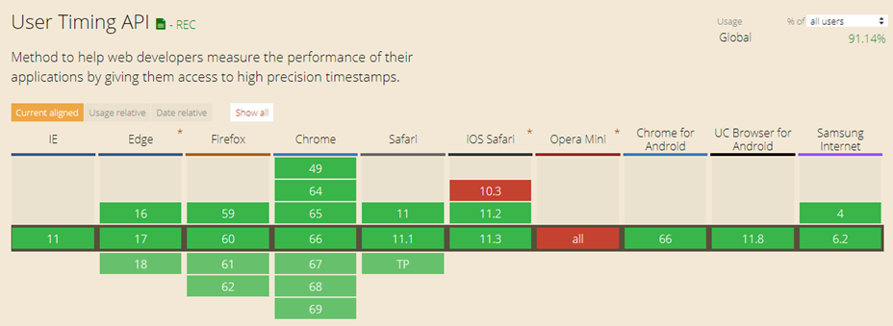
Can I use User Timing API?

Slide 53
Useful for: RAI
API #8 Long Task Timing
interface PerformanceLongTaskTiming : PerformanceEntry { readonly attribute FrozenArray<TaskAttributionTiming> attribution; };
name
startTime
duration
attribution
- attributing browser frame, e.g. “self” or “same-origin-ancestor”
- identify the frame and cause - currently only “script”
Accessible only via PerformanceObserver

Slide 54
Exercise #8 Long Task Timing API
1. Use your favorite site
2. Find the 3 longest long tasks, and log their identification to the console

Slide 55
3 ‘Extras’ Not part of Performance APIs, but impact measurements
#1 separate performance of pages in the background
#2 get the assumed network connection type
#3 send out information requests with Beacons

Slide 56
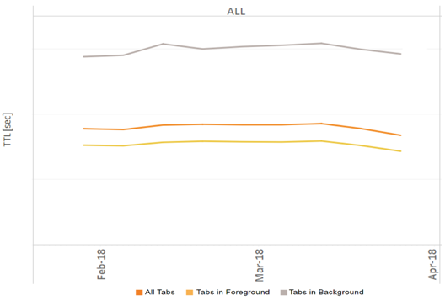
Browsers Throttle Background Tabs
Users generally don’t care that pages opened in the background take longer to load.
Background tabs
All tabs
Foreground tabs

Slide 57
EXTRA #1
Page Visibility API
Get page current visibility state: document.hidden
Callback document.onvisibilitychange when visibility changes

Slide 58
EXTRA #2
Network Information API
interface NetworkInformation : EventTarget {
readonly attribute EffectiveConnectionType effectiveType;
readonly attribute Megabit downlink;
readonly attribute Millisecond rtt;
readonly attribute boolean saveData;
attribute EventHandler onchange;
};
typedef unrestricted double Megabit;
typedef unsigned long long Millisecond;
enum EffectiveConnectionType {
"4g",
"3g",
"2g",
"slow-2g"
};
window.navigator.connection.effectiveType

Slide 59
EXTRA #3
Beacons
partial interface Navigator {
boolean sendBeacon(USVString url,
optional BodyInit? data = null);
};
DOMString, ArrayBufferView, Blob, or FormData
Send a Beacon
navigator.sendBeacon("/beacon", JSON.stringify(performance.getEntriesByType("navigation")));
Notes:
API designed specifically for sending notifications to server
Guaranteed to be initiated before page is unloaded and allowed to run to completion without requiring blocking requests
Prioritized to avoid competing with time-critical operations and higher priority network requests
Limits on payload size - not intended for background sync

Slide 60
Measure performance in dev, testing & production
For every aspect of RAIL
On all modern browsers
Using a single, common timeline
Summary
“If you can’t measure it, you can’t improve it.”
Peter Drucker
Notes:
Famous management consultant, educator, and author: https://en.wikipedia.org/wiki/Peter_Drucker

Slide 61
Thank You
dansh@wix.com twitter@DanShappir www.wix.engineering

